Slide 1

A BITE of BIG DATA

Slide 2
Why Xiachufang?
图1 2014.1-2015.5美食菜谱类App人均单日使用时间 数据来源：艾瑞咨询
图2 AppStore美食佳饮排行榜前15总览 数据来源：AppSto
Xiachufang is a UGC platform, on which people could share their creative recipes and others could make the same cuisine by following the recipe.
The communication atmosphere is well-established by operators and supported users.
People who chasing better quality of life attracts by its decent style.
Its DAU is 6 million and it has many loyalty fans.

Slide 3
1. 24 Hours Popular Dishes in Xiachufang

Slide 4
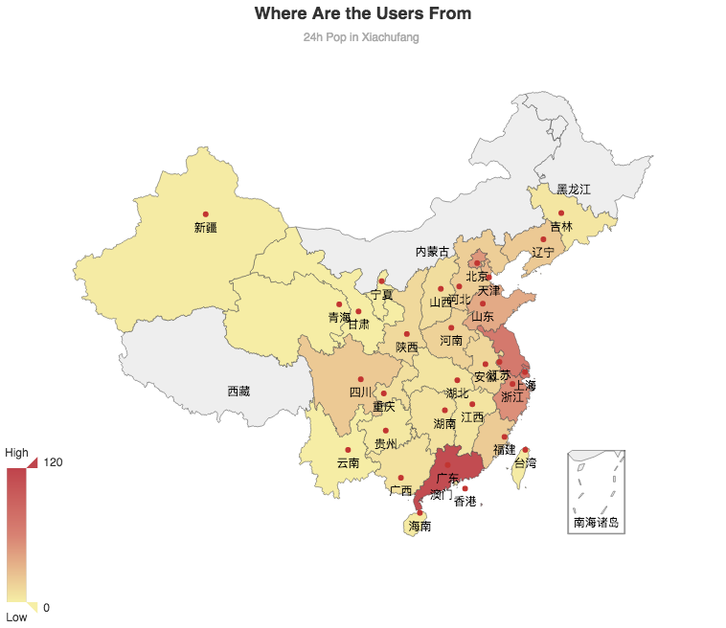
1.Most of their users come from economic developed area.
2.Top 3 of them are Guangdong, Shanghai and Jiangxu.
3.The trend in the heat map fits the China Engel‘s coefficient (恩格尔系数)2017 statistics.
江苏
61
上海
72
Insights：
1.Along with the consumption upgrading trend, people are not only interested in eating good food, but also making good food by themselves.
2.People are willing to share their good dished and gain the attention from others.
3.If you want to open a restaurant or combine the online and offline market, this map may be helpful.
广东
114
Map From Echarts Gallery :http://gallery.echartsjs.com/editor.html?c=map-china-dataRange

Slide 5
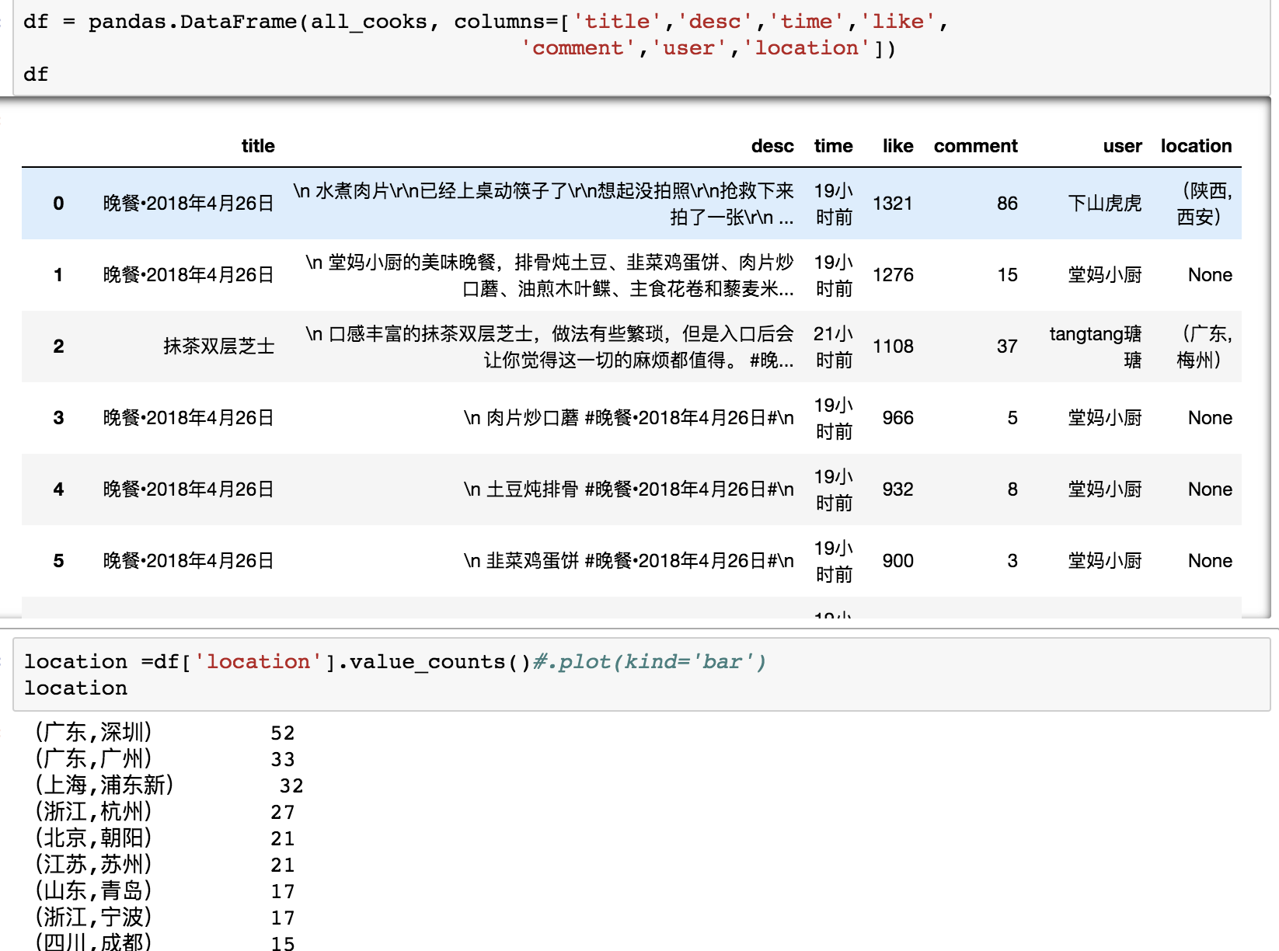
1.We got the data from 24h popular dishes. Yet there are some missing data.
2. We did the value counts on their locations, and found that the data was too specific. We just want to calculate the provinces.

Slide 6
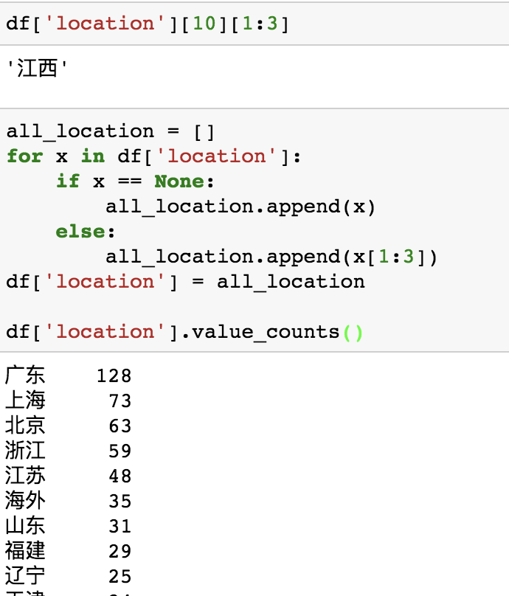
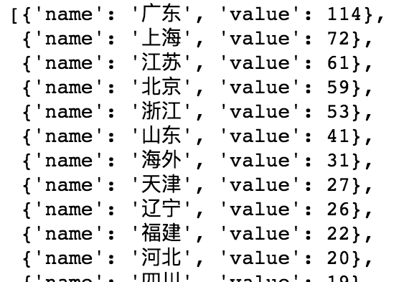
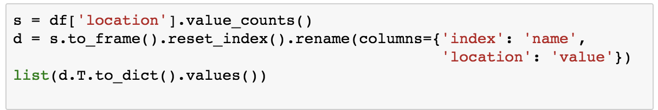
1.We used ‘for loop’ to make a new column to reset the location data frame.
2.Then we calculate the data of each provinces in China.
3. We chose Echarts Gallery, an online visualization tool, to visualize our data.
But it needs a specific data structure
4. We reset the data structure to fits Echarts Gallery, and finally got the heat map.

Slide 7
2. Pop in a Week in Xiachufang

Slide 8

We scraped 880 most hottest recipes in a week.
And analyze the various materials. We can see that the most frequently used materials are flour, eggs and butter.

Slide 9
When these three materials appear at the same time, do these remind you of something?

Slide 10
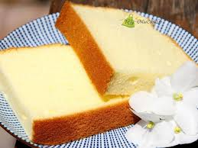
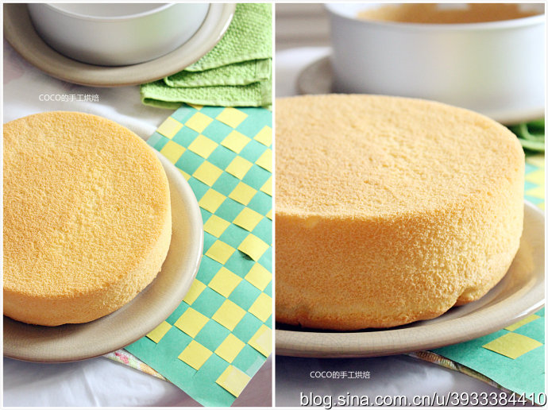
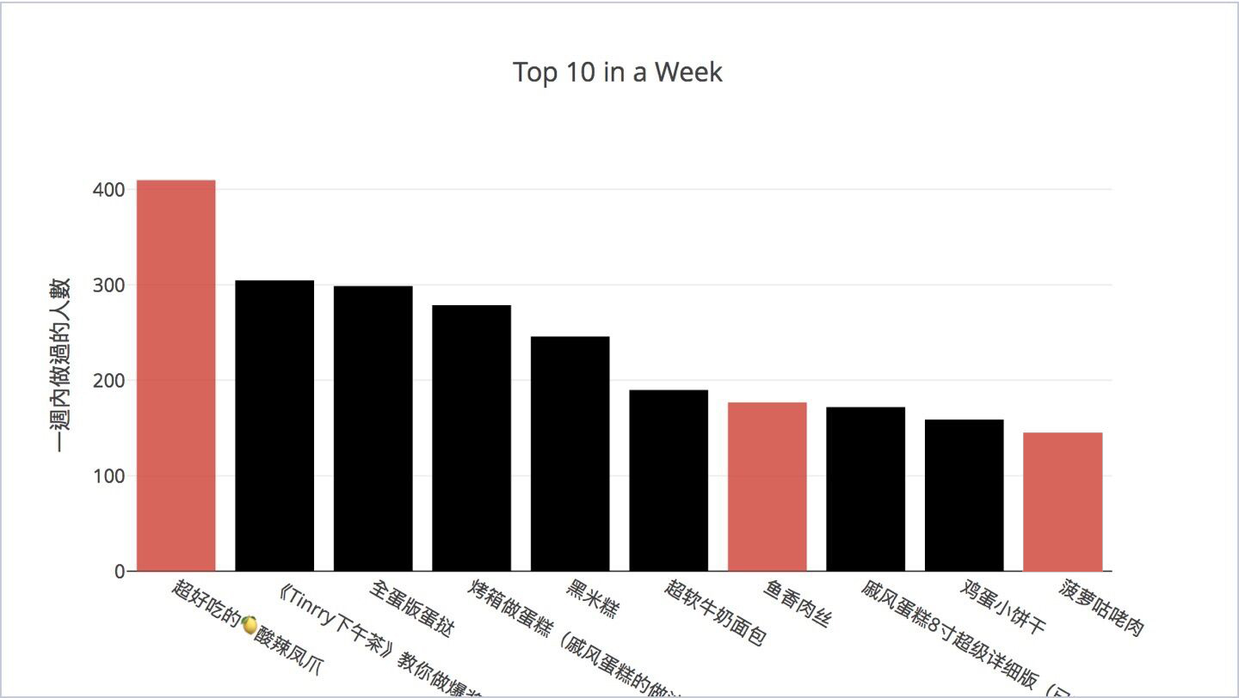
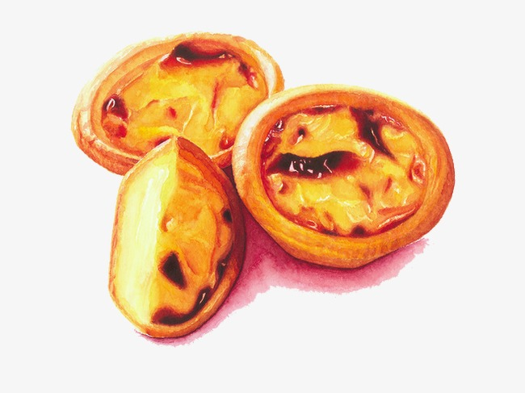
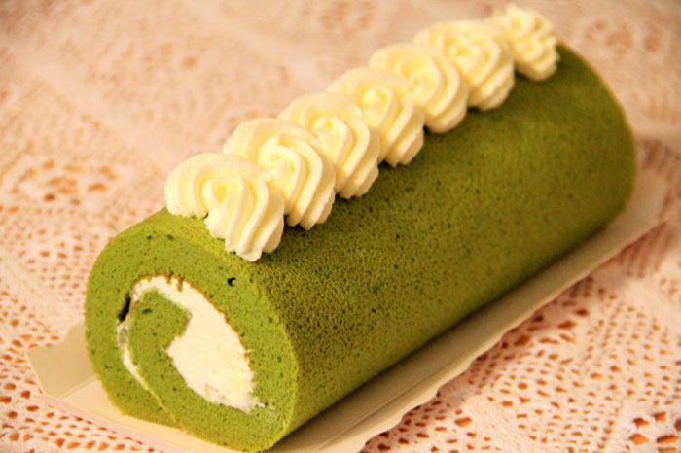
Here comes the dessert…

Slide 11
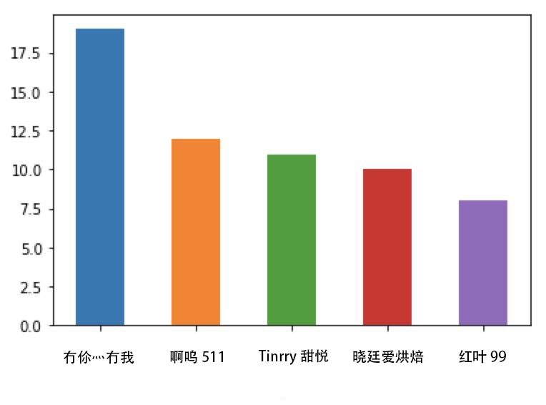
Let’s see the most welcome blogger.
The number shows the frequency of the bloggers’ recipe appearing in the whole rank.

Slide 12
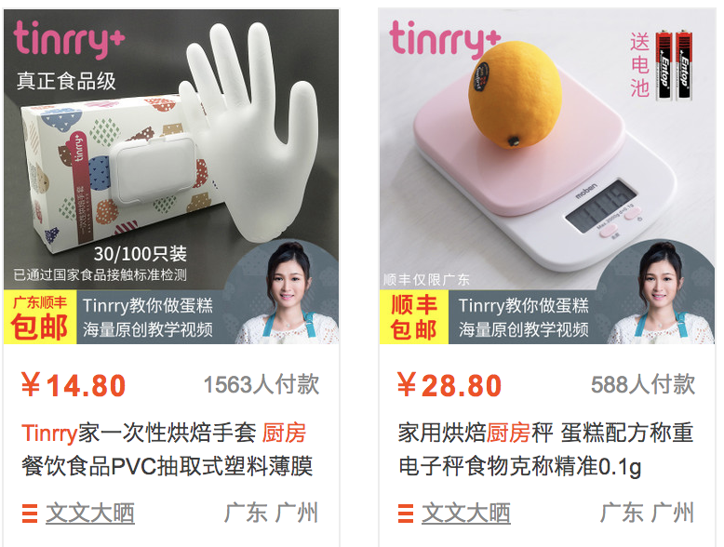
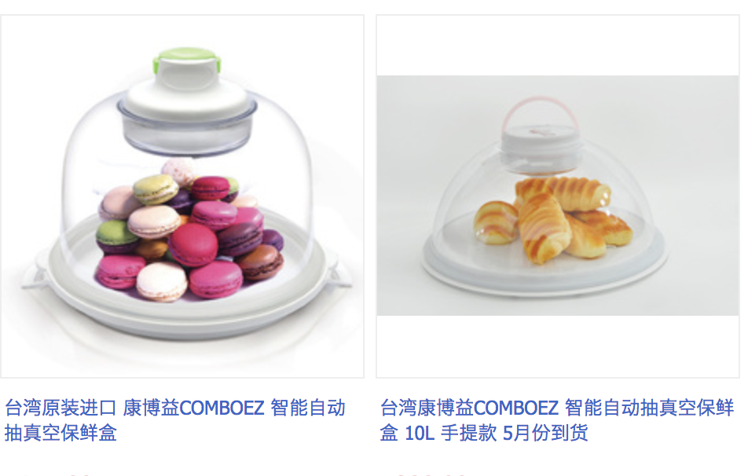
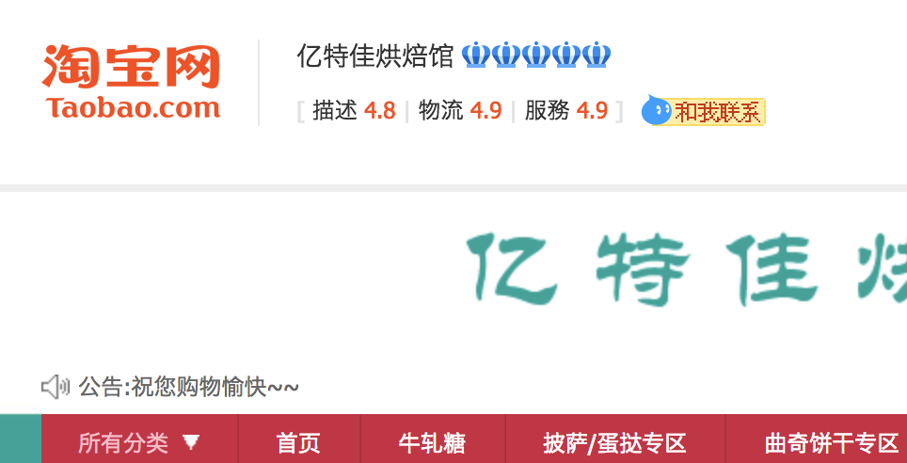
Three of them have their own ‘Taobao’shops.

Slide 13
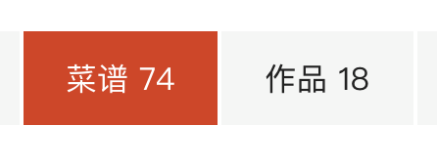
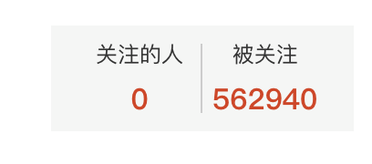


三百六十行，行行出‘网红’
Every industry has its own internet celebrities

Slide 14
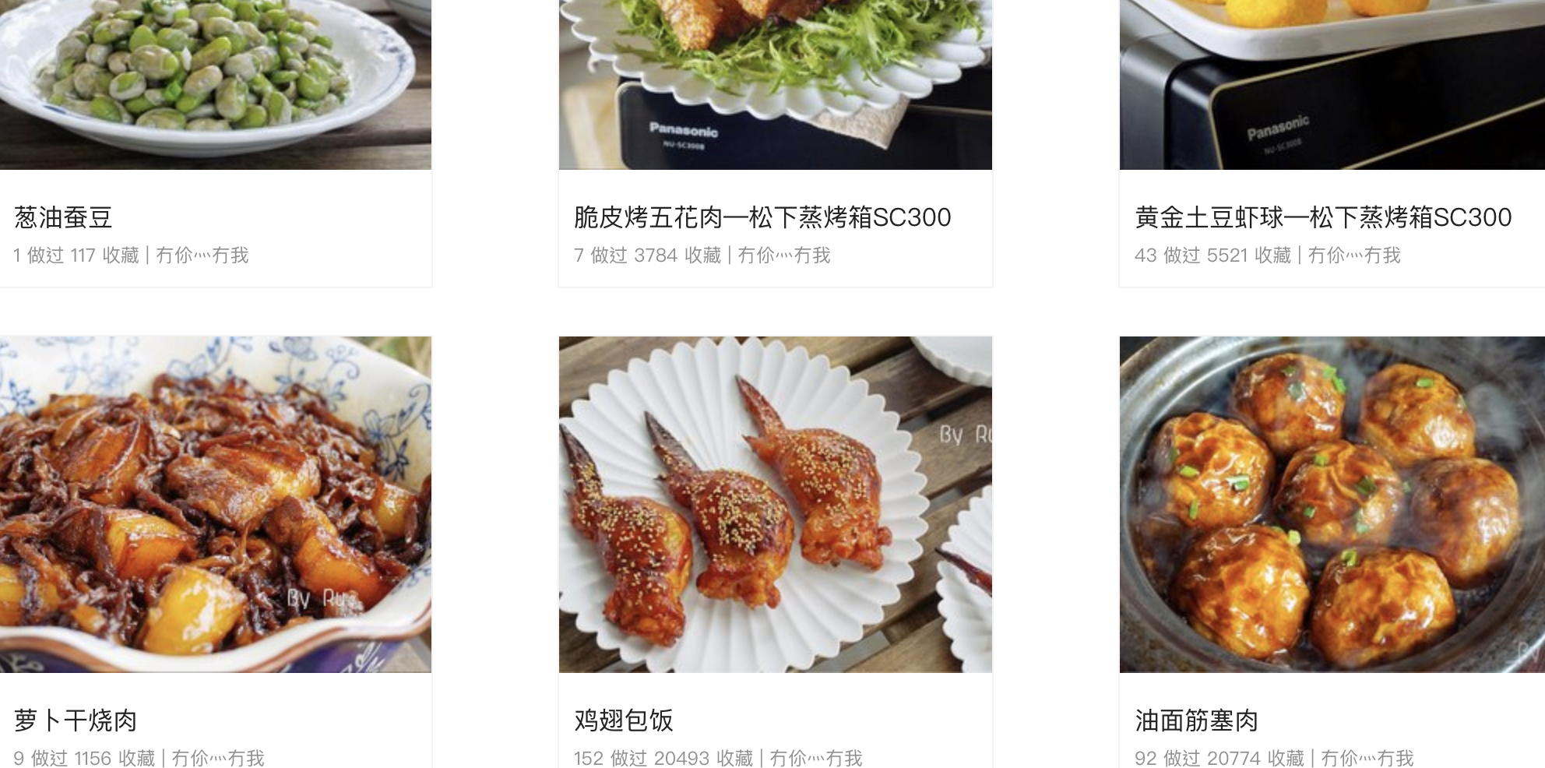
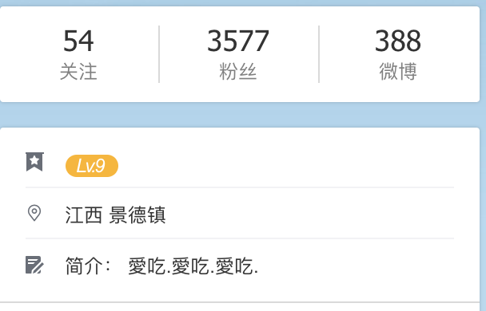
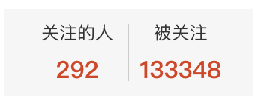
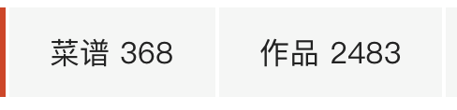
There is someone who is not as famous as the celebrate，and just love cooking.

Slide 15
If you want to be famous, just bake it;
If you want to cook, just enjoy it.

Slide 16
3. Foreign Recipes in Xiachufang

Slide 17
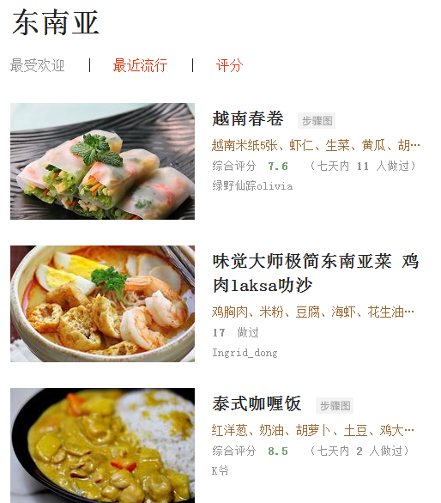
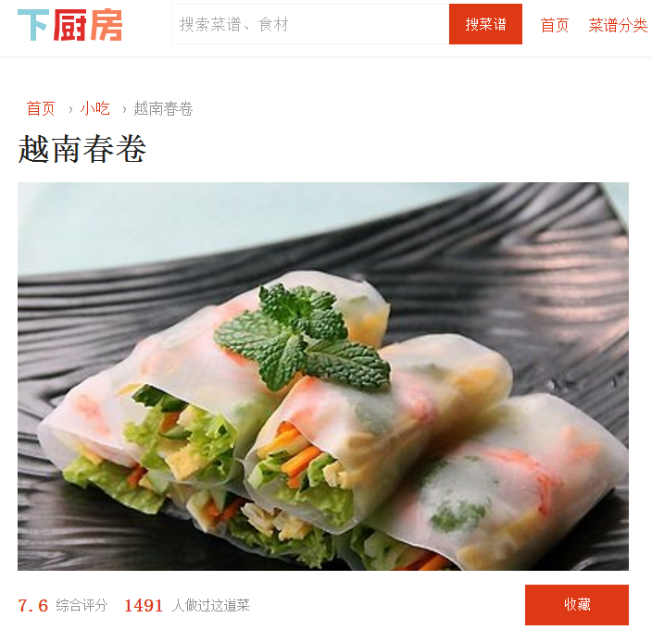

Slide 18
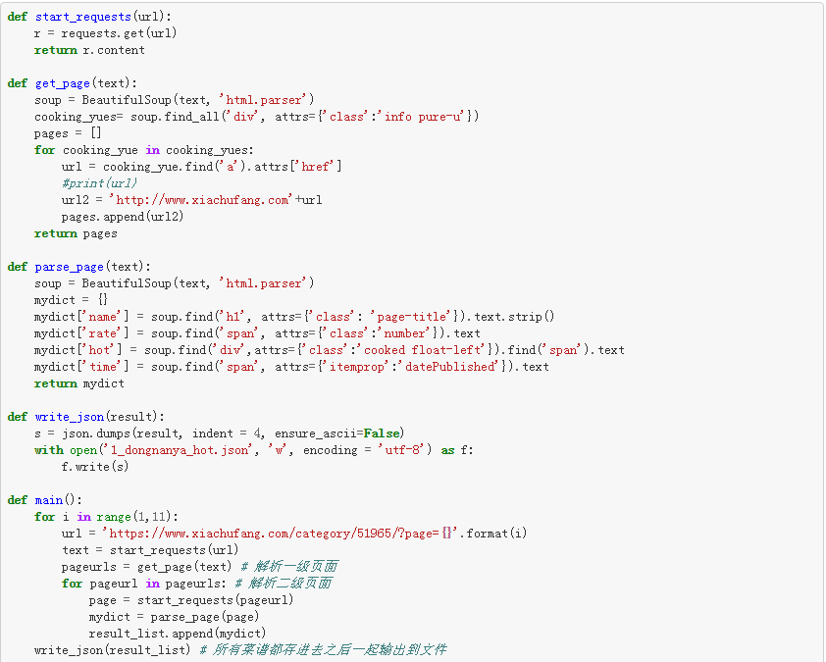
1. Scrap the data from Xiachufang Website in terms of Southeast Asian, Korean, Japanese and Western recipes, each including recipe's name, uploaded time, rate and hot (the number of people that has cooked the same recipe). Each kind of recipes has 10 pages, totally up to 800 recipes.
def: get the secondary subordinate page
def: find the details in the page
def: write into json
get 10 pages
and use above defs

Slide 19
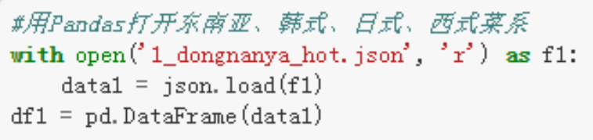
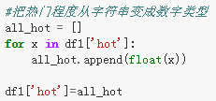
2. Use Pandas to open data
3. Clean data: change the str type in df1['hot'] into the float type so that it can be sorted.

Slide 20
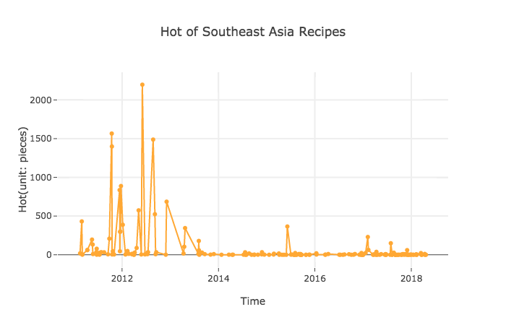
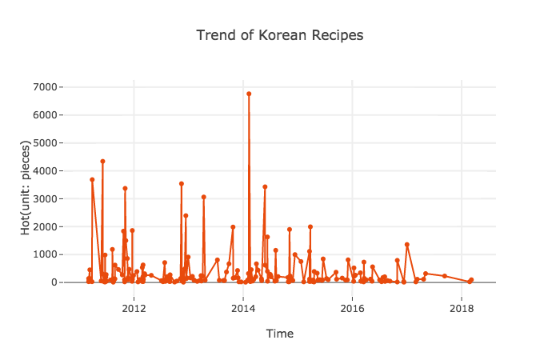
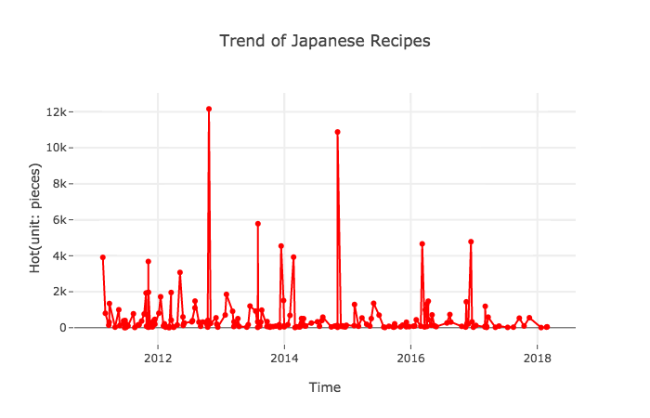
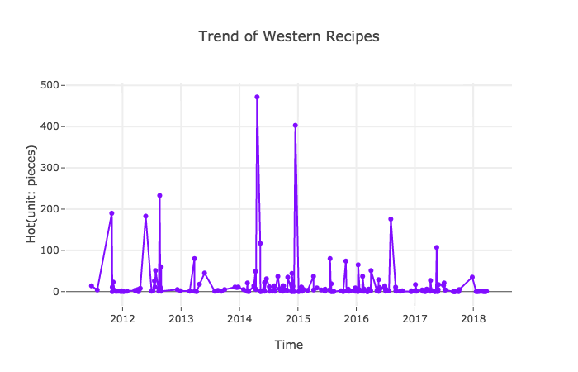
The Hot Trend of Southeast Asian, Korean, Japanese and Western Recipes
500
500
500
500

Slide 21
The Hot Trend of Southeast Asian, Korean, Japanese and Western Recipes
1. The Janpanese and Korean recipes are very popular in Xiachufang App. The Western recipes are not popular with average lower than 500 people doing a recipe of this kind.
2.The Southeast Asia recipes uploaded during 2011 and 2013 are popular, but after 2014, this kind of recipes are not so popular by users. Unlike other three kinds of recipes are relatively balanced.
Analysis 1: Easier to be cooked, hotter it may be.

Slide 22
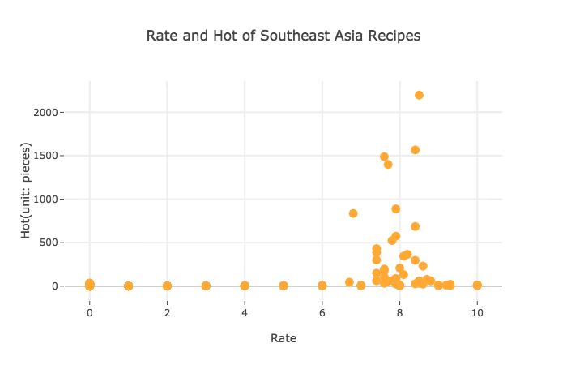
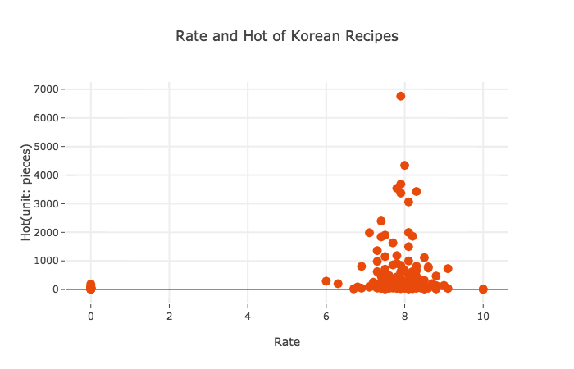
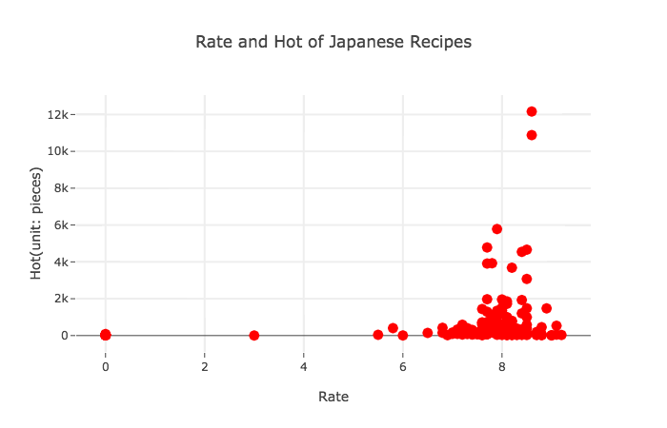
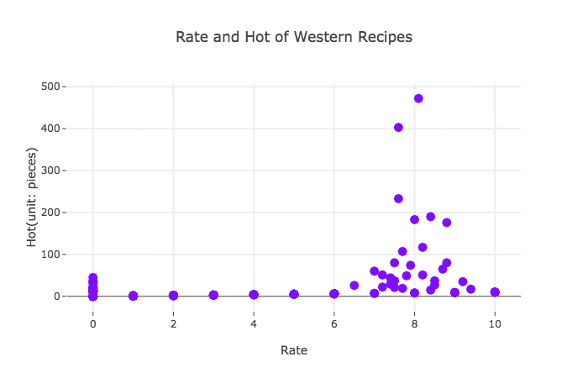
Comparison between Hot and Rate
Note: Some rates missing are written as “zero”.

Slide 23
The Comparision between Rate and Hot of Southeast Asian, Korean, Japanese and Western Recipes
1. Generally, rate and hot of a kind of recipe has a positive relationship as we assumed before the test.
2. But we still find out that some Southeast Asian and Western recipes has various rate from low to high while has little hot.
Analysis 2: It may because of missing some data or people just like some recipes but they don’t want to cook them.

Slide 24
4. The relationship of Chinese cuisines
dimensionality reduction: TSNE

Slide 25
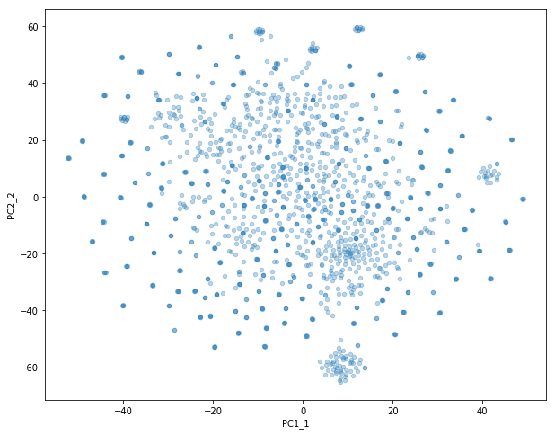
Layout of 1497 Chinese recipes from Xiachufang
Searching cuisines by eight traditional cuisines, we gain 1497 recipes including name, materials and detail recipes.
Sichuan cuisine
Guangdong cuisine
Hunan cuisine
Shandong cuisine
Fujian cuisine
Jiangsu cuisine
Zhejiang cuisine
Anhui cuisine

Slide 26


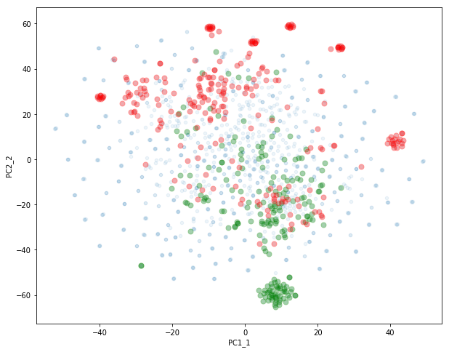
Guangdong cuisine VS. Sichuan cuisine
Data distribution：
Even there are some superposition and close dots, the discrepancy is quite large.
More information form：
Besides, compared with Guangzhou cuisine, The distribution of recipe of Sichuan cuisine is more scattered, which means the Sichuan cuisine is more versatile and more diverse.

Slide 27
Guangdong cuisine VS. Sichuan cuisine
The classic dishes in Sichuan cuisine：
Sichuan Pickles（四川泡菜）
The classic dishes in Guangzhou cuisine：
Cantonese mooncake：
1.Very focused, validating our previous discussions that dessert-type foods are very popular in Xiachufang.
2.a potentially large number of bloggers selling desserts in Xiachufang.
Sichuan Pickles
Cantonese mooncake

Slide 28

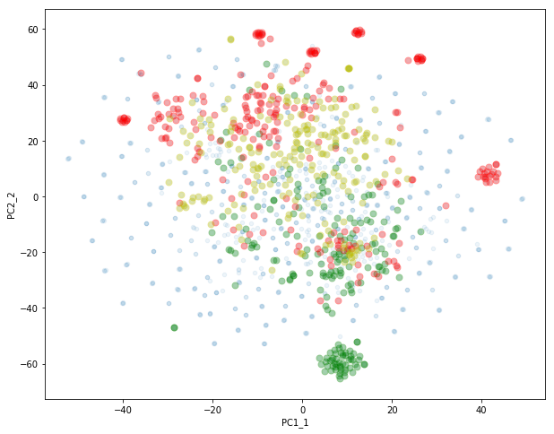
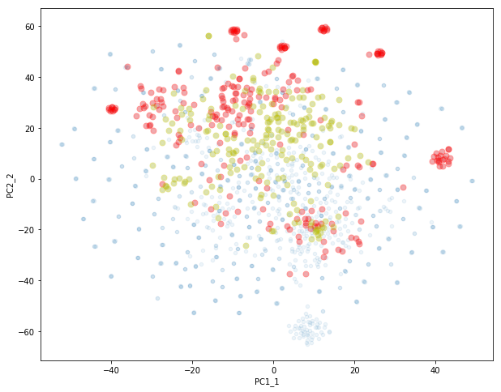
Sichuan cuisine VS. Hunan cuisine
The recipes of Hunan cuisine and Sichuan cuisine are closer in the map.
Besides, compared with Sichuan cuisine, The distribution of Hunan cuisine is more concentrated.
Still, Sichuan recipes are more diverse.

Slide 29

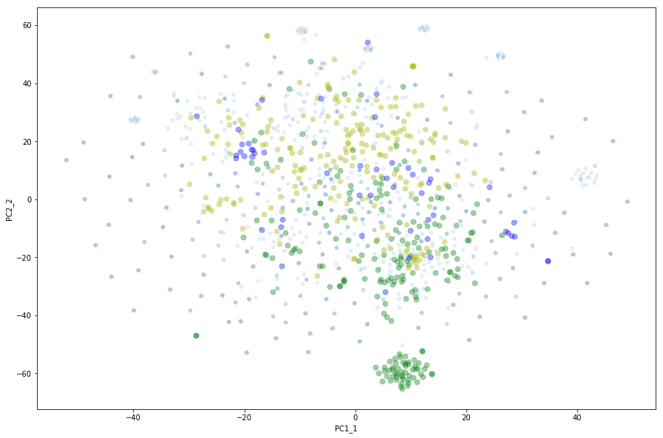
Shandong cuisine
The recipes of Shandong cuisine are closer with Hunan compared with Guangdong, which mean the dishes of Shandong and Hunan have more similarity.
Unlike Wikipedia‘s description of cuisine, in our chart, Cantonese dishes which carry light diet has intersections with spicy Hunan dishes, and Shandong dishes featuring thick oil sauce.
Because the other four cuisines are not popular in Xiachufang, sample are mixed with similar recipes of standing dishes, so we only compared the four popular and representative recipes.

Slide 30
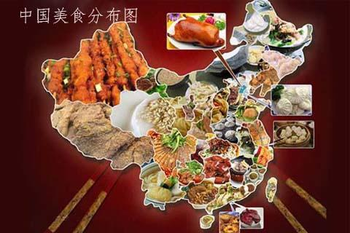
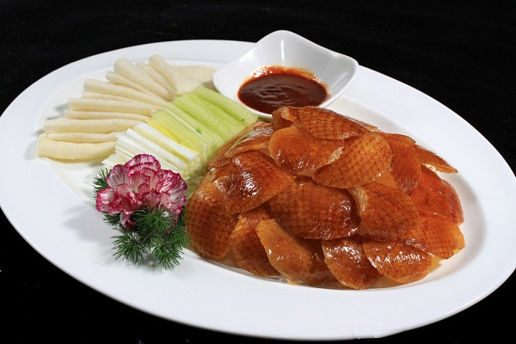
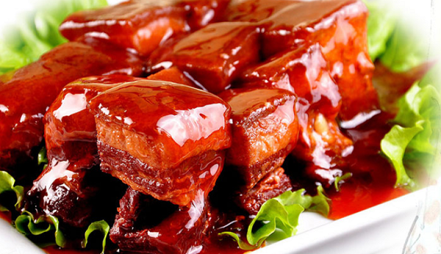
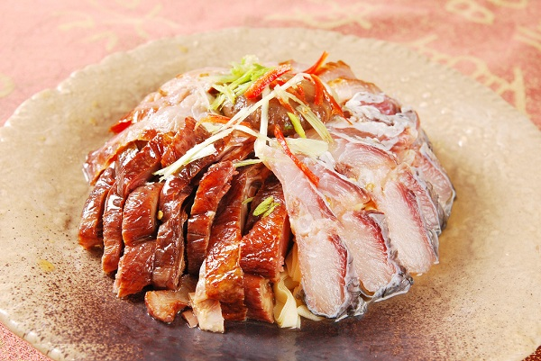
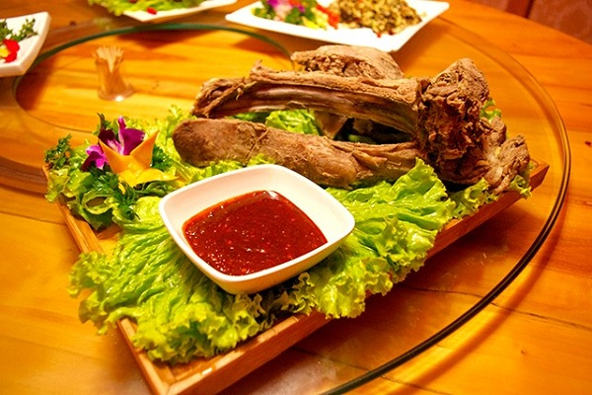
Eight Traditional Cuisines
In official definition, the difference of the eight traditional cuisines in Chinese society is quite large.
Due to the differences in geography, climate, customs, and specialty products, the local cuisine has formed different local flavors.

Slide 31
Layout of 1497 Chinese recipes from Xiachufang
But in our data, things is different, the recipes of four representative cuisine, to some extent, are closely integrated with each other, although there are still some difference.
The reason should be:
1. the recipes are posted by Xiachufang users, and majority of them are sharing home cooking recipes, which are more convenient and simple than traditional practice.
2. The traditional cuisine categories can no longer represent the taste of the public. Because of dishes cuisine are always changing with time and popularity mobility.

Slide 32
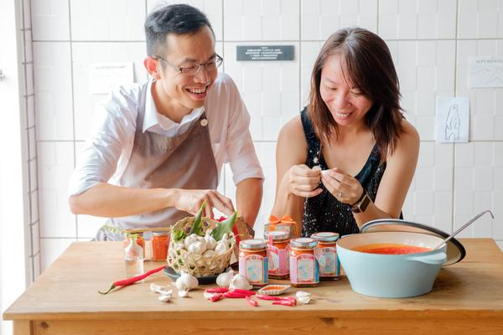
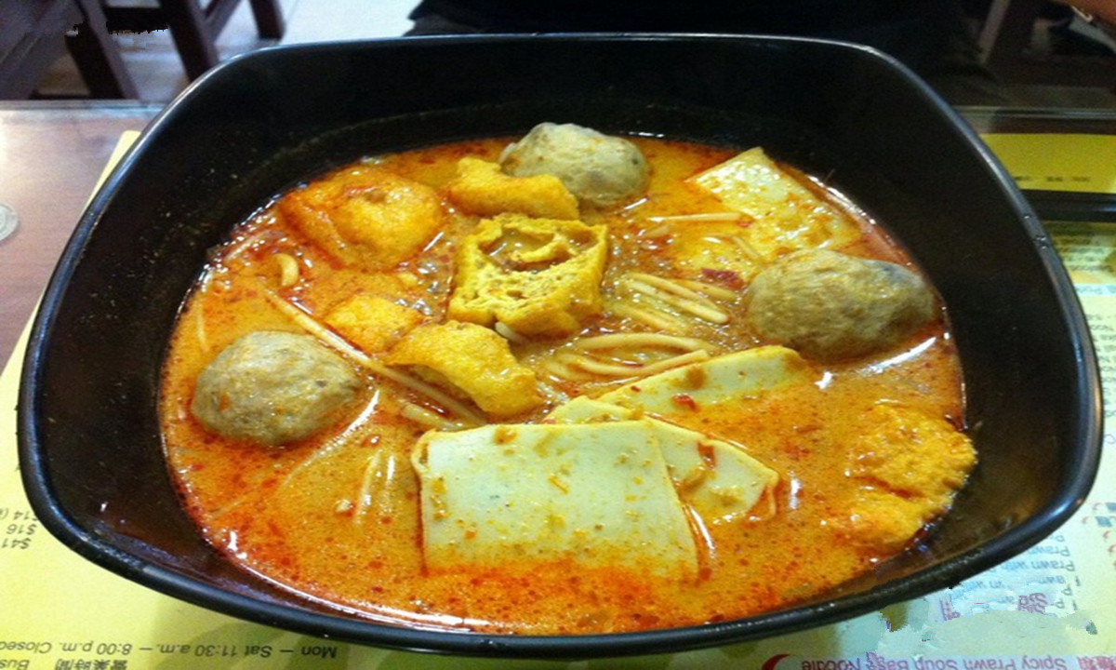
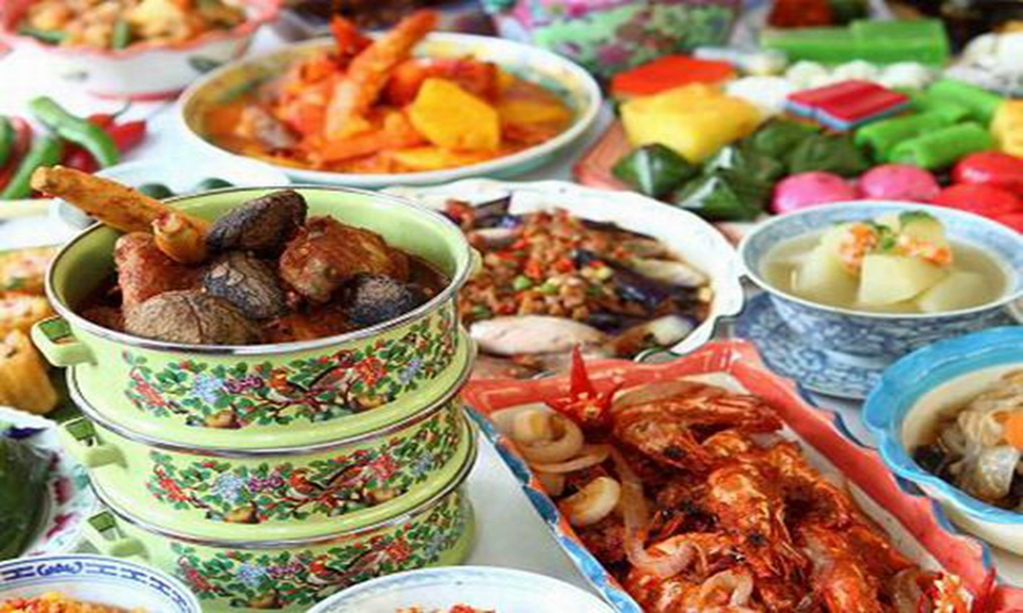
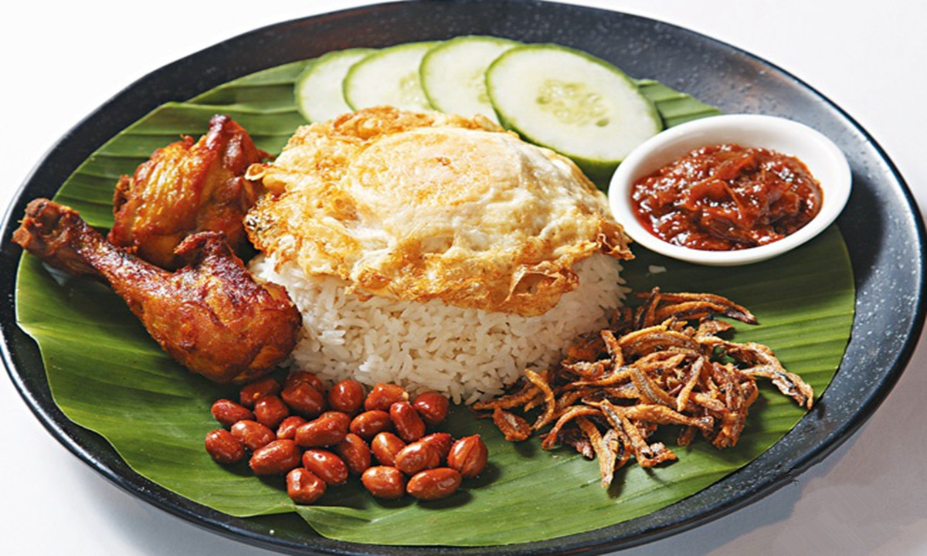
Nyonya cuisine（娘惹菜）
Nyonya cuisine:
A popular cuisine at Southeast Asian Singapore, Malaysia, Indonesia and Thailand. Originated from Chinese immigrants living in Penang, Malacca, and Singapore.
Integration and mixed taste:
The authentic cuisine of Singapore, the traditional Chinese food and Malay spice combine perfectly with each other, combining sweet and sour. The sauces used are made up of at least ten kinds of spices.
Prevalence:
In addition to Malacca, Nyonya cuisine spread to Indonesia and Thailand.

Slide 33
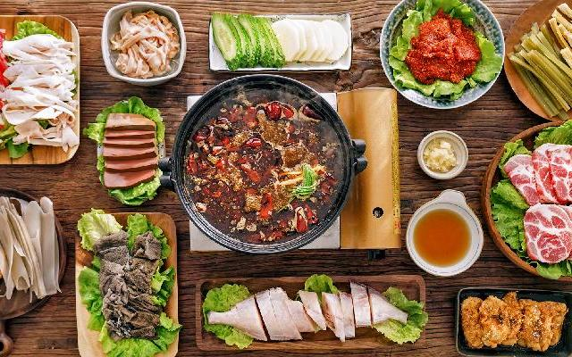


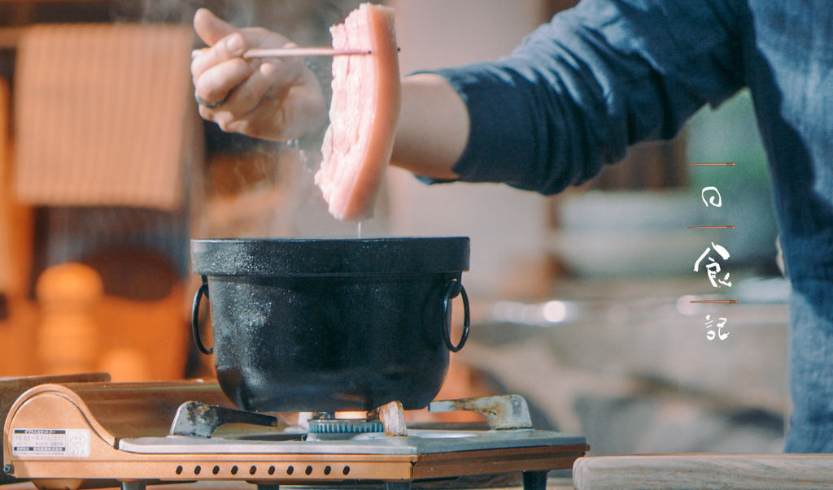
Some Clues from Data:
Renew cuisine categories are forming or has already formed？
1.Geographic factors influence are marginalized
2.More frequent population mobility:
Go to university
Career option
3.Sharing culture

Slide 34
Thank You
Group Members:
17441781 CHEN Yanhua
17438578 LIU Wanyin
17408067 PENG Yu
17422353 GAO XING

Slide 35
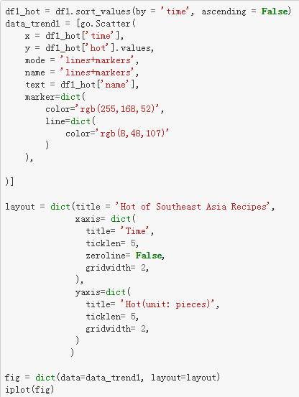

Appendix

Slide 36




1. 东南亚、韩式、日式、西式菜谱年度热门趋势图
1. The Hot Trend of Southeast Asian, Korean, Japanese and Western Recipes

